Slide 1

AUTOMATED FINANCE: THE RISE OF
ROBO-ADVISORS
Andrei Luchici
INTERNATIONAL INFORMATICS HIGH SCHOOL
BUCHAREST
17.05.2024

Slide 2

DISCLAIMER
The algorithms and strategies presented in this tutorial are for educational purposes only and are not intended to provide financial or trading advice. The performance of the models and strategies demonstrated herein is based on historical data and may not accurately predict future market behavior. Trading financial markets involves substantial risk and may not be suitable for all investors. You should consult with a qualified financial advisor before making any investment decisions. The authors and publishers of this tutorial are not responsible for any losses incurred as a result of using the information contained within.

Slide 3

Hello,
I’m Andrei
I am a lecturer in the Department of Computer Science for Business Management and the executive director of the Center for Research in AI (CRAI) at Romanian-American University in Bucharest, Romania.
In my work, I integrate mathematics, computer science, complex adaptive systems, and neuroscience to build autonomous systems that are effective and safe for working alongside people.

Slide 4



Agenda
Part 1 - Boring presentation
The making of the robo-advisors
Part 2 - Interactive demo & coding
Predicting investor feelings
Part 3 - More coding
Predicting and trading the market

Slide 5
PART 1
The making of the robo-advisors

Slide 6

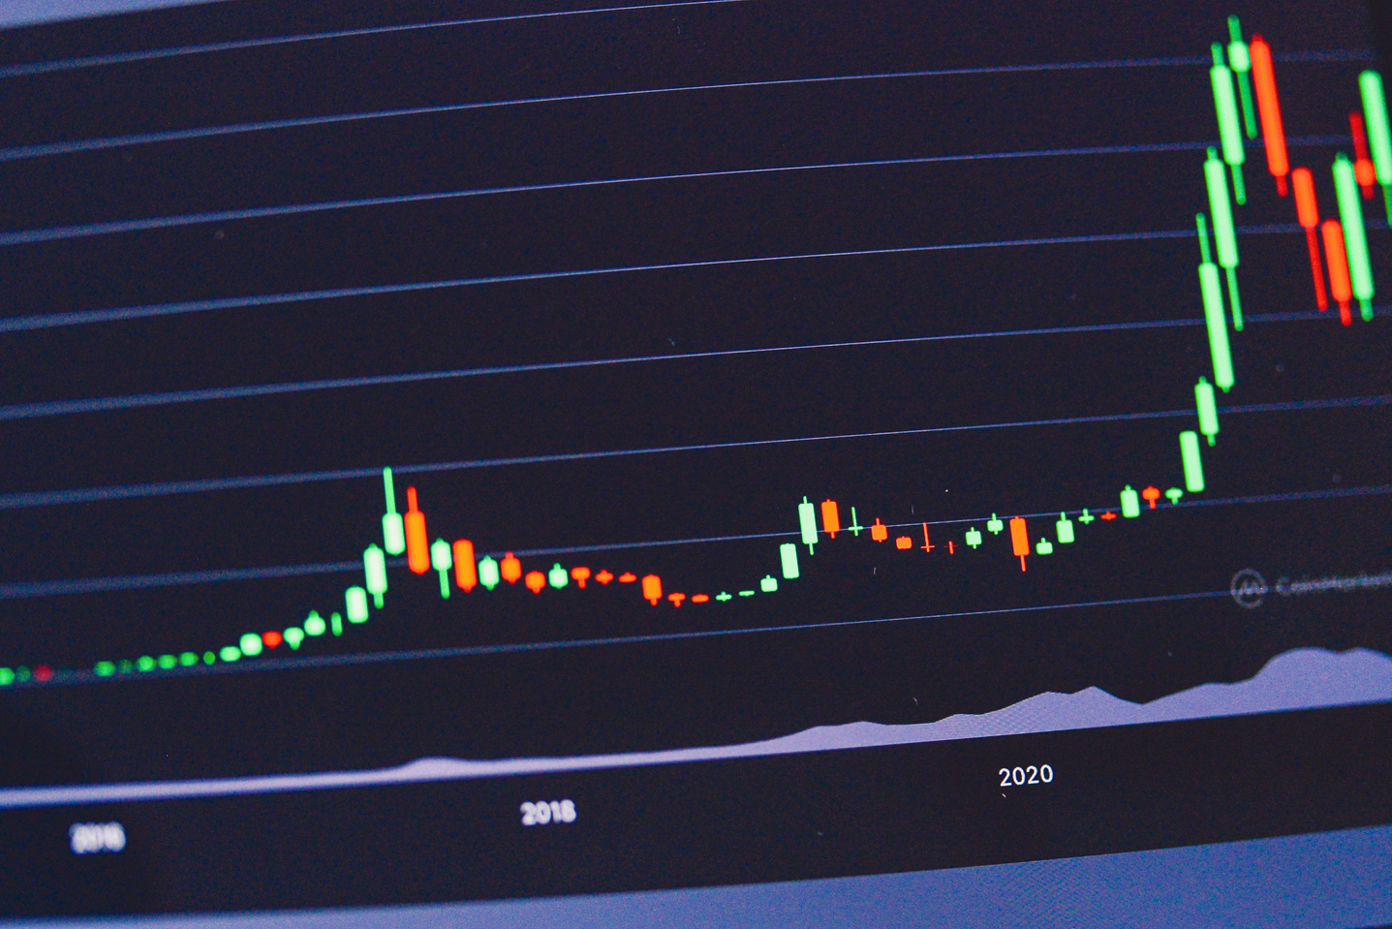
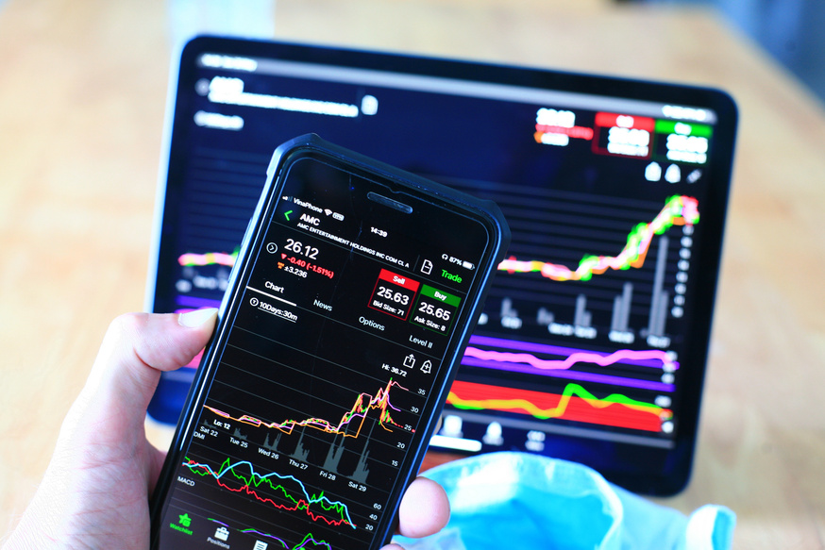

Why do we care?
Financial markets are messy
Financial markets are influenced by a wide range of factors, including economic indicators, geopolitical events, and market sentiment. This complexity makes accurate simulation difficult.
Financial time series data often exhibit non-stationary properties, meaning their statistical properties, like mean and variance, change over time.
Sudden market movements due to unexpected news or events can cause significant deviations from predicted prices, challenging accurate simulation.
Good predictions are key
Accurate market price predictions are important for trading strategies, risk management, investment decisions, and policy development.

Slide 7
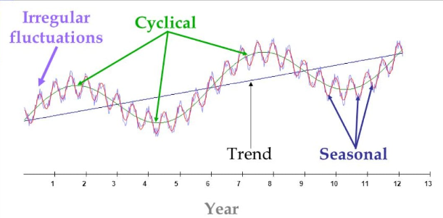
A bit of history
Image source:
https://www.springboard.com/blog/data-science/time-series-forecasting/

Slide 8
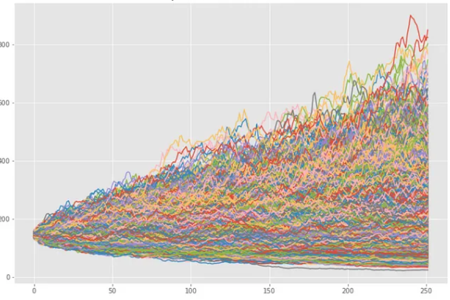
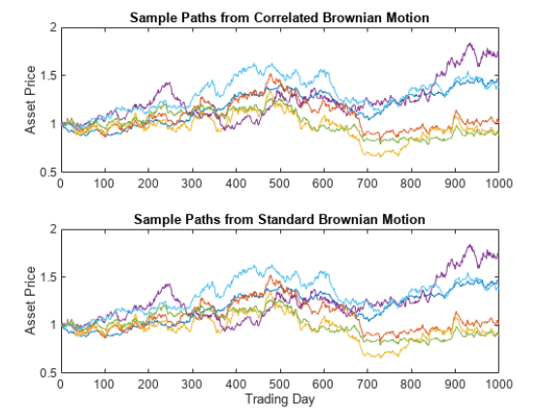
A bit of history
Image source (left to right)
https://medium.com/@igorshestopalov/a-practical-guide-to-using-monte-carlo-simulations-for-predicting-stock-prices-e4406a1b6d9b
https://www.mathworks.com/help/finance/example-simulating-equity-prices.html

Slide 9
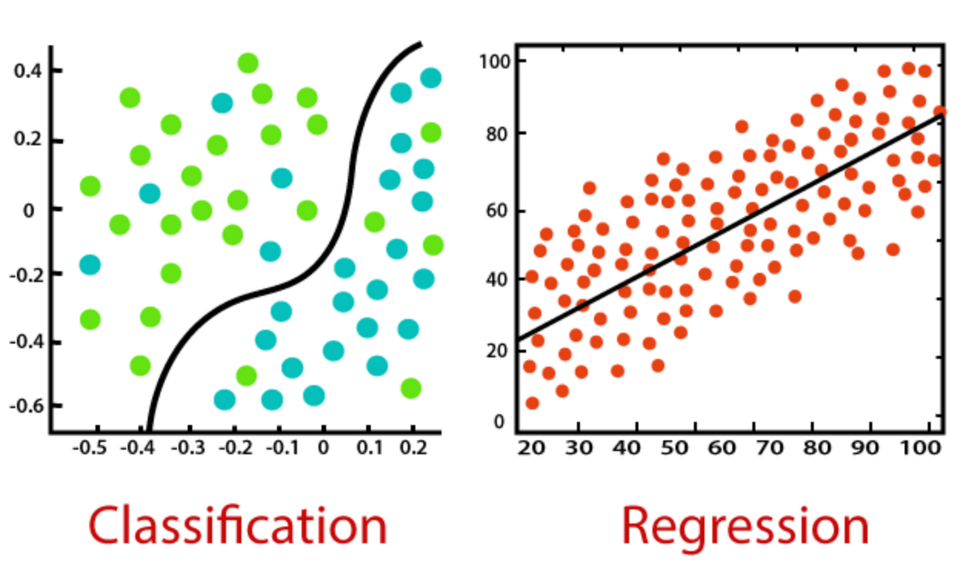
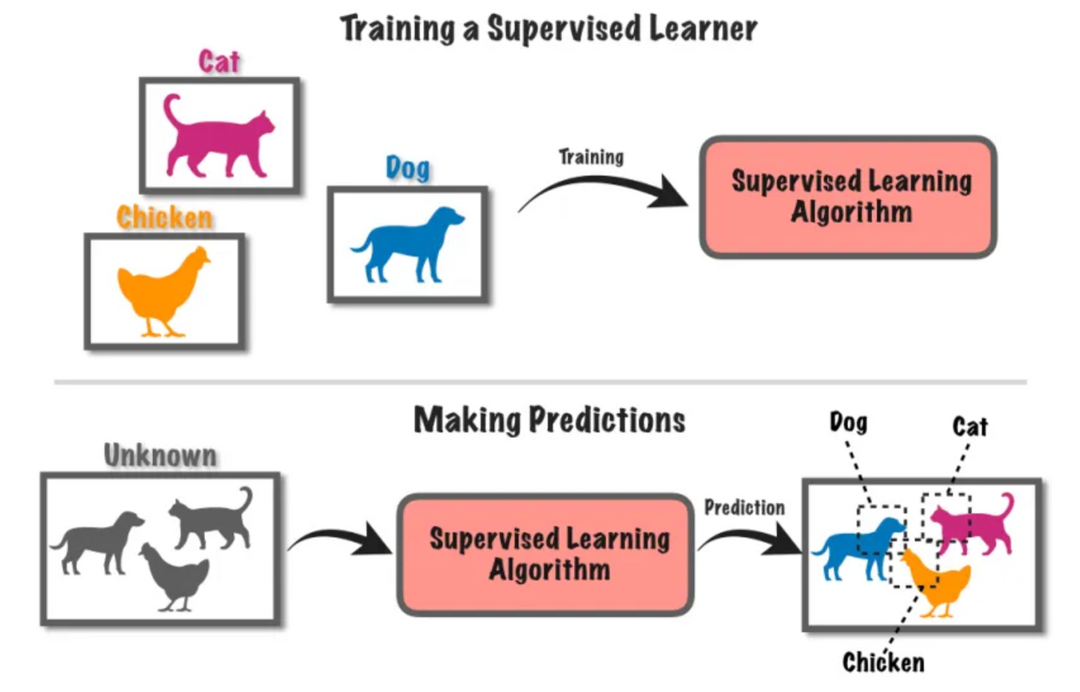
A (relatively) new age of computing
Image source (left to right)
https://towardsdatascience.com/supervised-vs-unsupervised-learning-in-2-minutes-72dad148f242
https://www.javatpoint.com/regression-vs-classification-in-machine-learning

Slide 10
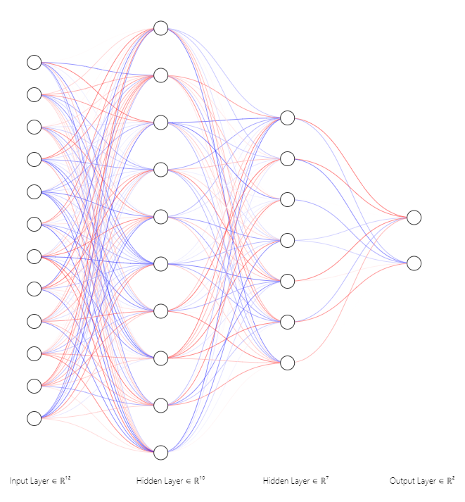
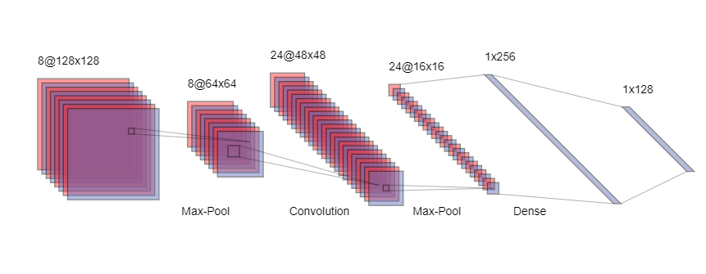
Deep Neural Networks

Slide 11
PART 2
What are people feeling?
LIVE DEMO

Slide 12
COLAB LINK
https://shorturl.at/8JJoD
LIVE DEMO

Slide 13
PART 3
Looking into the future

Slide 14
COLAB LINK
https://shorturl.at/hveAa
LIVE DEMO

Slide 15

Thank you
Any questions?

